Slide 1

NATURAL LANGUAGE PROCESSING

Slide 2

HANDLING TEXT IN ML
  So far, the algorithms that we have seen take as input tabular information with numeric or categorical data.
  There are several areas of application where our data is not natively structured in this way: sound, image and text come to mind
  In these situations we often reduce the problem to turning the native data format into a suitable set of features, followed by applying the typical ML algorithms.
  In other words: how do we turn text into a suitable set of numbers?

Slide 3
HANDLING TEXT IN ML
Some of this feature generation can and should come from metadata:
  source of text
  date of production
  author
But ultimately it is clear that most of the information must come from the body of the text.

Slide 4
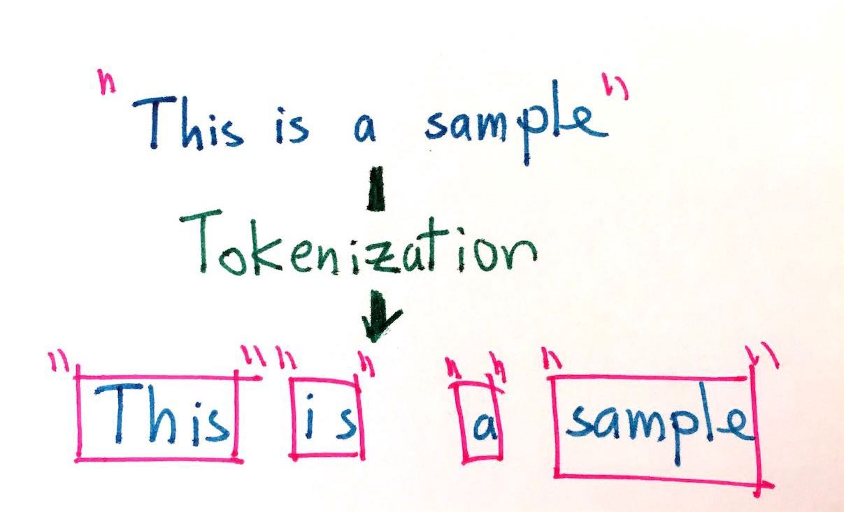
TEXT DATA CLEANING TECHNIQUES
  Tokenization
  The process involves taking any text and splitting it into "tokens"
  Usually the tokens chosen are individual words but can be sentences as well.
PROBLEMS: YOU CAN LOSE IMPORTANT MEANING LIKE "NEW YORK" GETS SPLIT INTO "NEW" AND "YORK" THUS LOSING THE GEOGRAPHICAL MEANING. A GOOD MACHINE LEARNING APPLICATION WOULD TAKE THIS INTO CONSIDERATION BY CONSIDERING THE RELATIVE FREQUENCY OF PAIRS OF WORDS AND PERHAPS KEEP THOSE PAIRS AS A SINGLE WORD

Slide 5
Jupyter

Slide 6
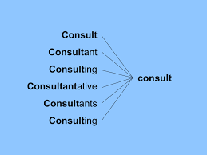
TEXT DATA CLEANING TECHNIQUES
  Stemming
  Removing prefixes and suffixes in order to reduce synonym words into their common form
  This can lead to some problems of creating spurious relations
  Stripes -> Strip
  Strip -> Strip

Slide 7
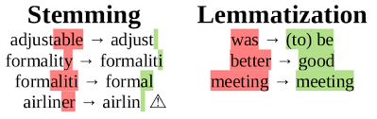
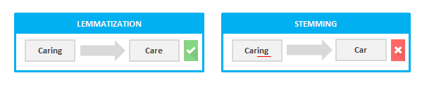
TEXT DATA CLEANING TECHNIQUES
lemmatization looks beyond word reduction and considers a language’s full vocabulary to apply a morphological analysis to words. The lemma of ‘was’ is ‘be’ and the lemma of ‘mice’ is ‘mouse’.

Slide 8
Jupyter

Slide 9
TEXT DATA CLEANING TECHNIQUES
  Part-of-Speech tagging (POS)
  Can be a very valuable feature
  Used heavily in Natural Language Generation (NLG)
  In that use case the "next word" is heavily dependent on the previous
POS tagging (Part-of-Speech tagging) in Natural Language Processing (NLP) is the process of labeling each word in a sentence with its corresponding part of speech, such as noun, verb, adjective, etc.

Slide 10
Jupyter

Slide 11
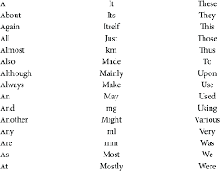

TEXT DATA CLEANING TECHNIQUES
Removal of stop words
Stop words are common words which are usually removed to not be interpreted as noise

Slide 12
Jupyter

Slide 13
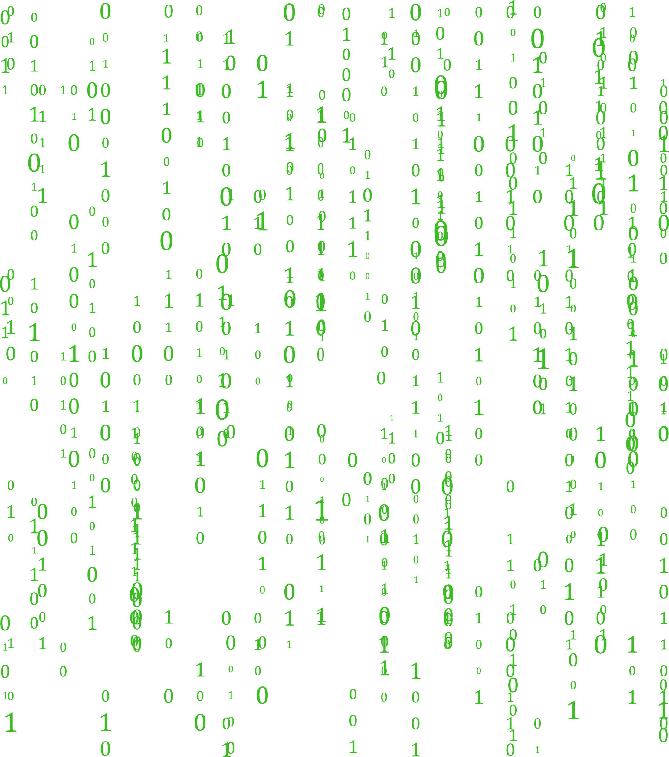
BAG OF WORDS
Bag of Words model is a standard way to decompose any text into several features that can then be used to train a classifier.
The method consists of taking all the words from all the corpuses/documents/rows and performing one-hot encoding. However, the final value is a frequency of the word rather than a binary variable
In essence, each distinct word becomes a feature

Slide 14
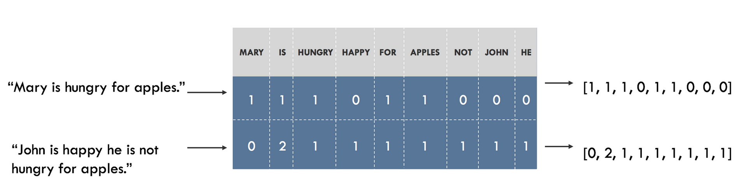
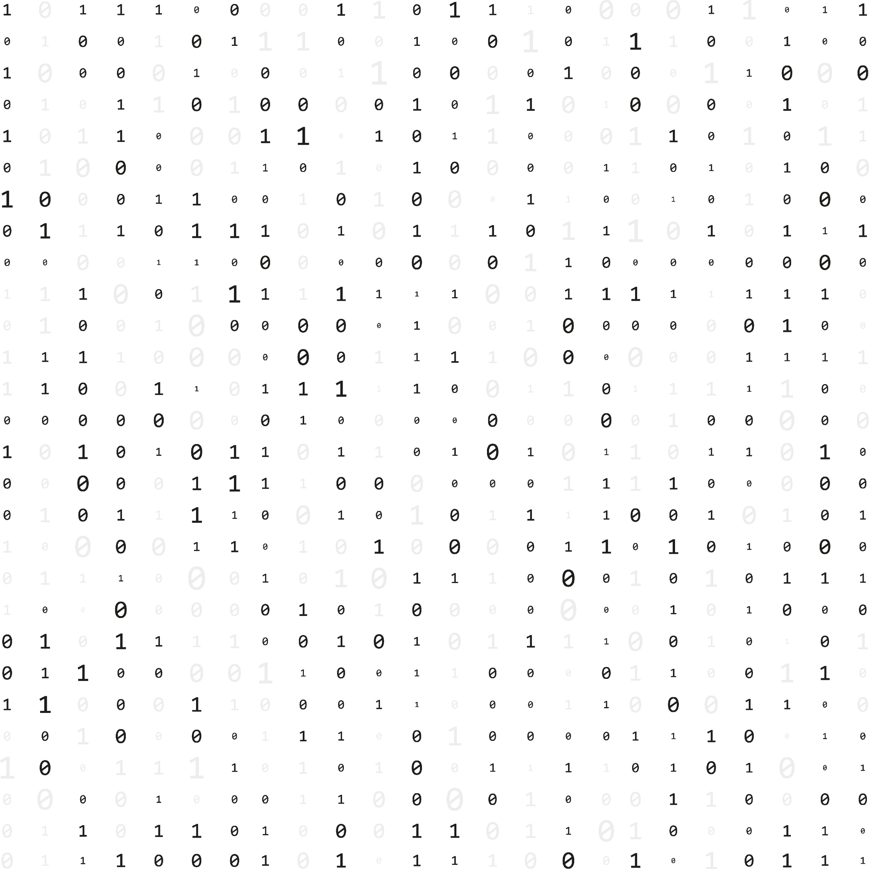
BAG OF WORDS

Slide 15
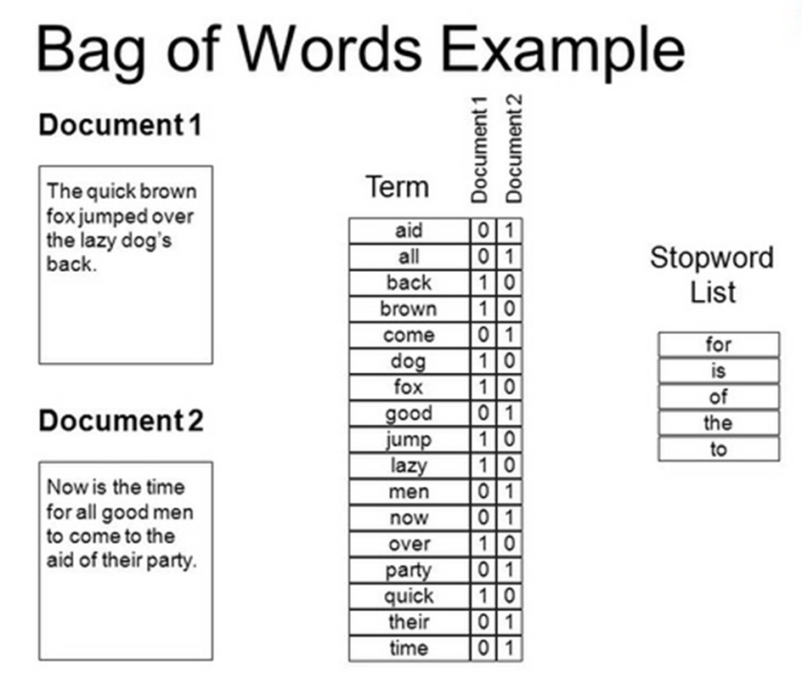
BAG OF WORDS
Problems of bag of words:
- you lose the context of the words within the sentence
- assumes all words are independent
"this is not bad" -> "bad"
solution: N-Grams performing bag of words but with pairs of sequential words for example:
"this is" ; "is not" ; "not bad" would be your features

Slide 16
Jupyter

Slide 17
TF-IDF
Term Frequency Inverse Document Frequency (TF-IDF) is one of the most important feature engineering techniques in natural language processing
It combines two metrics:
Term Frequency (TF) – How often a word appears in a document.
Inverse Document Frequency (IDF) – How unique or rare the word is across all documents.
Weighs how important a word is in a specific document and how rare it is in all the collections of documents

Slide 18
TF-IDF
High TF-IDF score -> word appears many times in a document but is rare in collection of documents
Low TF-IDF score -> word that appears moderately in a document but is extremely common in collection of documents

Slide 19
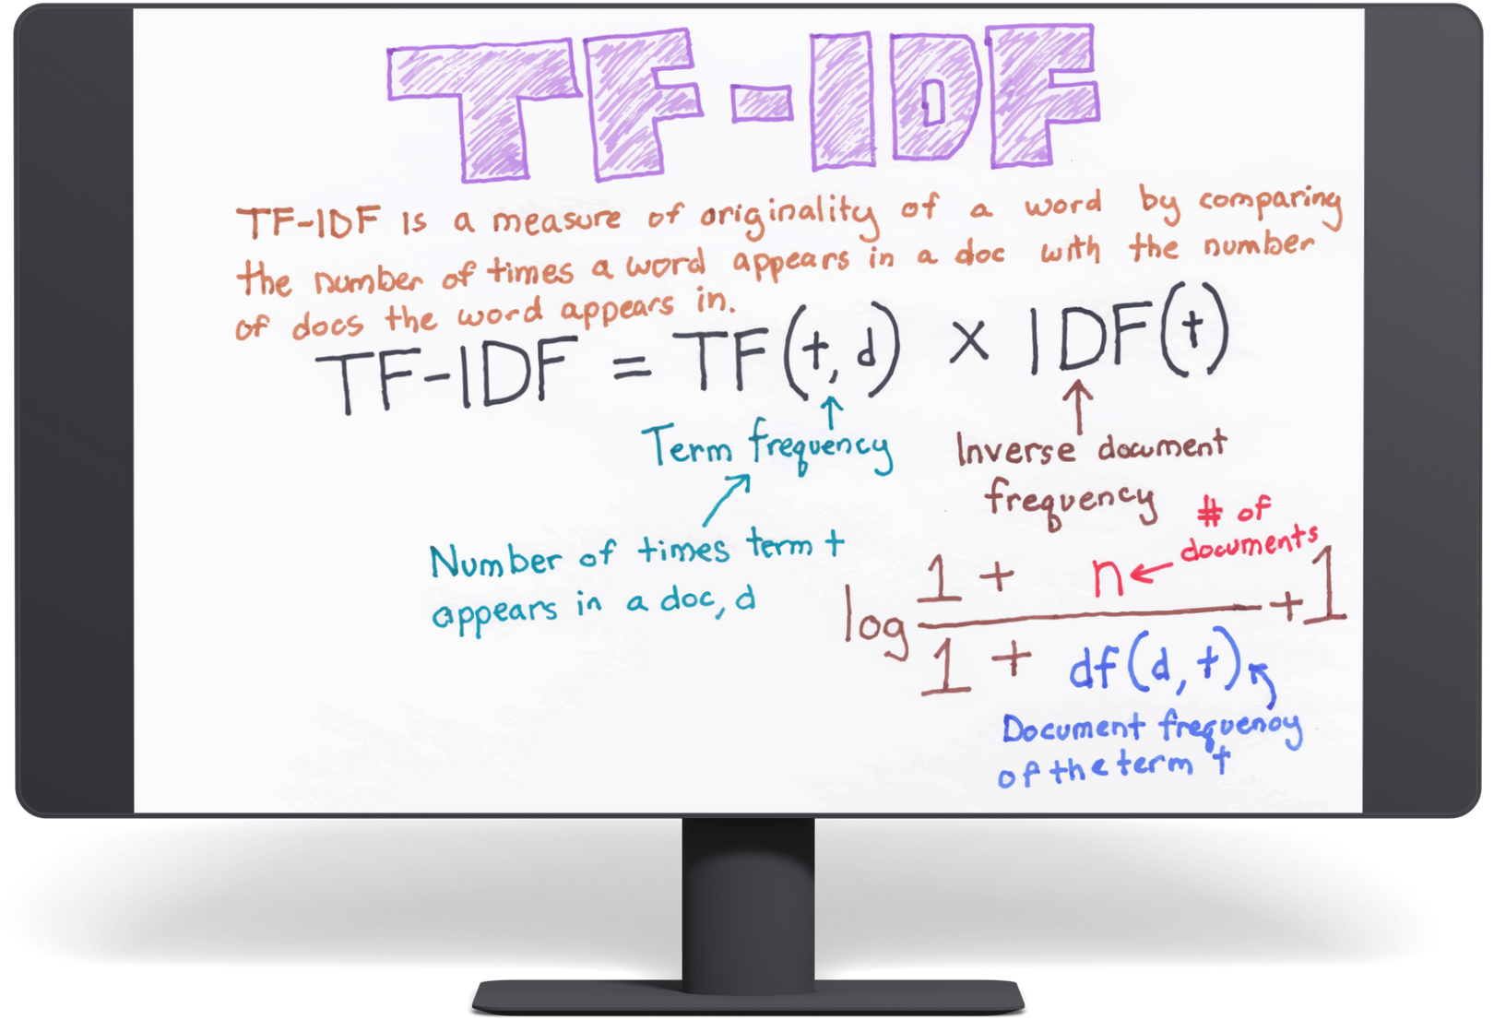
TF-IDF

Slide 20

ANY QUESTIONS ?

